Slide 1
Iterator & Composite Pattern
Well-Managed Collections

Slide 2
Displaying things in a collection
It is very handy to be able to “visit” every item in a collection without worrying about how the collection is implemented.
Print out the elements in the following array:

Slide 3
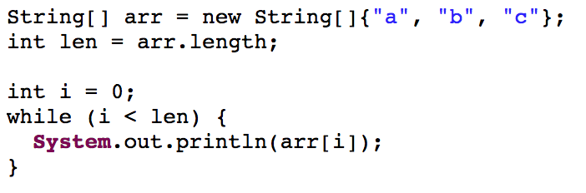
Displaying things in a collection
It is very handy to be able to “visit” every item in a collection without worrying about how the collection is implemented.
Infinite loop

Slide 4
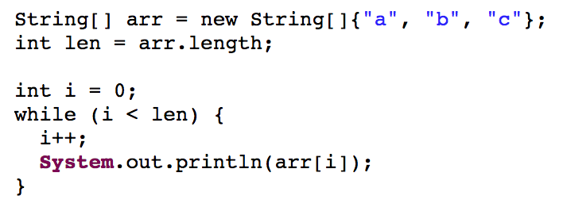
Displaying things in a collection
How about this?
ArrayIndexOutOfBoundsException

Slide 5
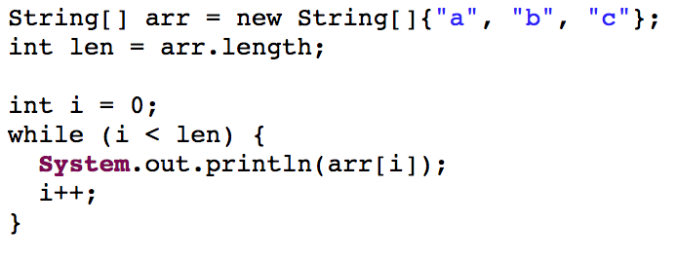
Displaying things in a collection
How about this?

Slide 6
Displaying things in a collection
To correctly iterate through the array, you need to:
Know that array index starts at 0
The index of the last element of the array is the length minus one
increment i AFTER accessing the element (otherwise you start at -1)

Slide 7
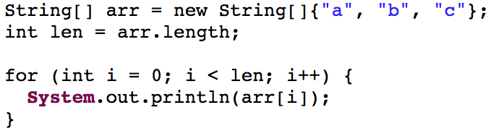
Displaying things in a collection
Is this better?

Slide 8
Displaying things in a collection
To correctly iterate through the array, you need to:
Know that array index starts at 0
The index of the last element of the array is the length minus one
increment i after accessing the element (otherwise you start at -1)

Slide 9
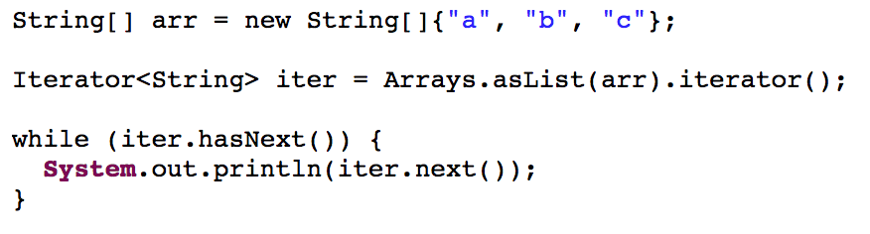
Displaying things in a collection
To correctly iterate through the array, you need to:
How about just: the collection can be iterated?
Java Lists can be iterated. They have ”iterators”.

Slide 10
Displaying things in a collection
Still has the ugly while loop
However, if the collection has a java.util.Iterator, you do not need to know about the internal structure of the collection.
e.g. ArrayList, LinkedList, HashSet, …
You still need to know when to stop: when the iterator does not have next. But it is about the iterator.
Notes:
Map().entrySet().iterator()

Slide 11
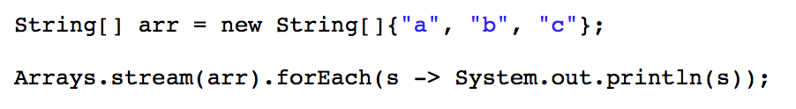
Displaying things in a collection
Higher order functions, e.g., forEach()
Many languages have these since a long time ago: Python, Scala, Ruby, …
Before Java 8, you may use com.google.guava
Notes:
The while loop disapears.

Slide 12
who controls the iteration?
External Iterator:
When the client controls the iteration
while (iter.hasNext()) … iter.next() …
Internal Iterator:
When the “iterator” controls the iteration
forEach …

Slide 13
Traversing through collections
Traversing the Cells in the Environment
Book’s Example: Combining Menus
Objectville Diner joins Objectville Pancake House
Notes:
…
So the waitress will show you two menus

Slide 14
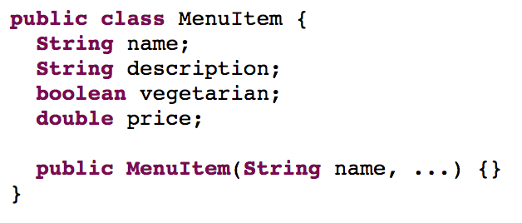
menu item
Notes:
Each Menu contains several menu items

Slide 15
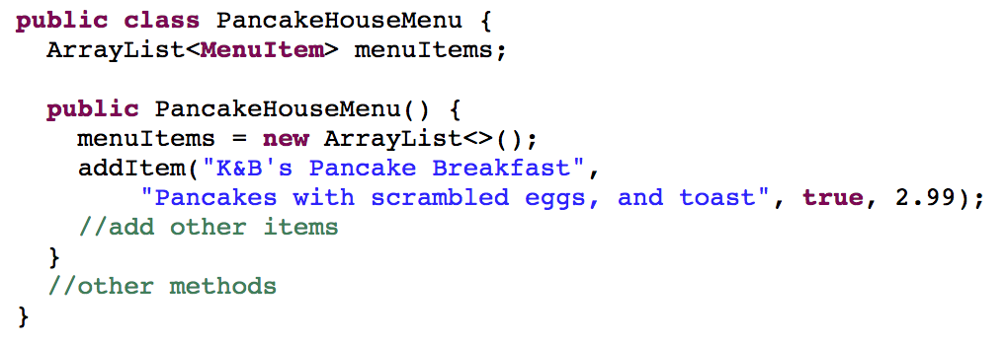
pancake house menu
Notes:
The menu items are store in an arraylist.

Slide 16
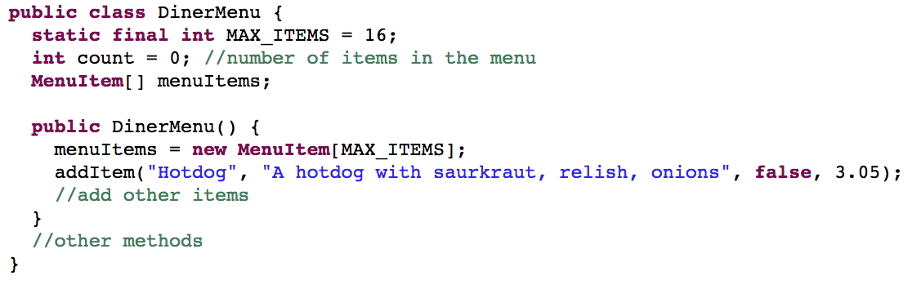
diner menu
Notes:
hard to write add menu
maintain

Slide 17
combining their menus
The Waitress should be able to create custom menus for customers
the whole menu
just lunch or dinner items
just vegetarian items
should know if an item is vegetarian or not

Slide 18
First attempt
https://repl.it/@engr120/iterator-inclass
Notes:
different ways to get items
different ways to get size
different ways to get a certain element

Slide 19
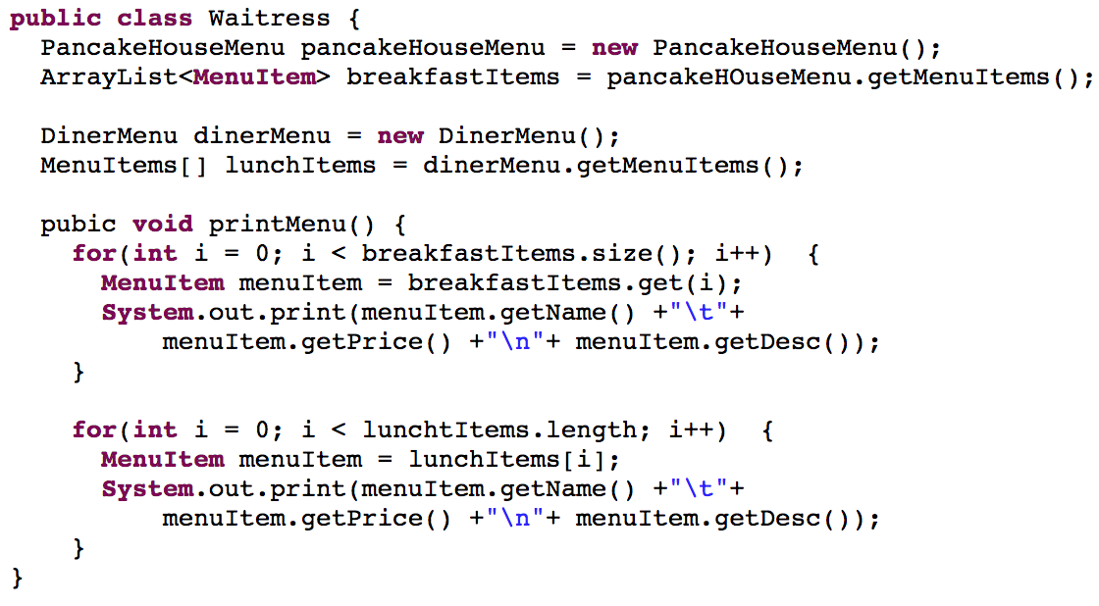
First attempt
Notes:
different ways to get items
different ways to get size
different ways to get a certain element

Slide 20
encapsulate what varies
We have to handle different collections in different ways
We would like to encapsulate the difference of the traversal for a certain kind of collection
We are going to create a new class that encapsulates the data structure and provides interface to step through it
So that a client (waitress) can traverse the two menus in the same way
Notes:
Throughout the course, we are talking about

Slide 21
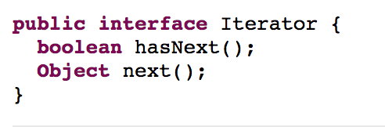
Define an iterator
hasNext() returns a boolean indicating if there are more elements to iterate over.
next() does TWO things
returns the “next” element
and advances to the next element

Slide 22
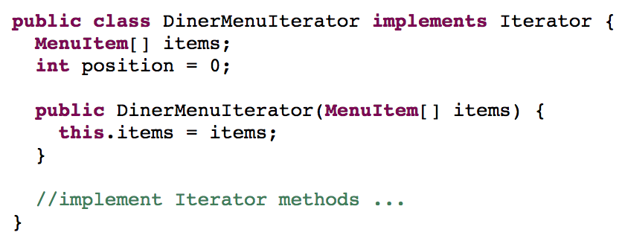
Diner menu iterator

Slide 23
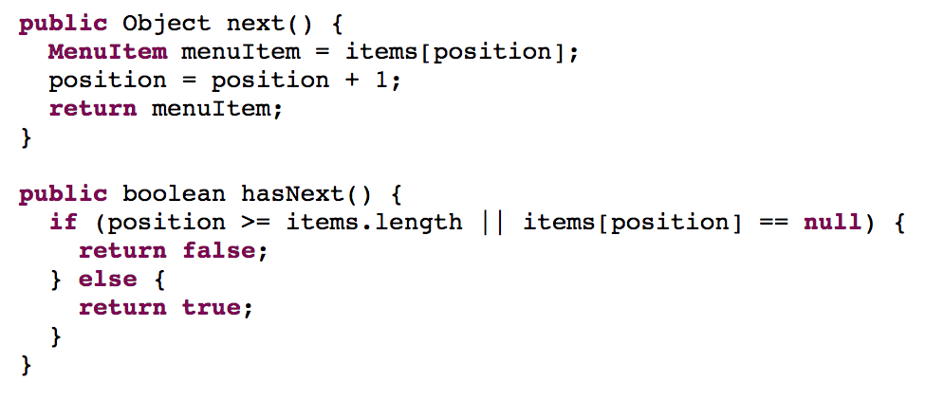
diner menu iterator
Notes:
This iterator encapsulates the structure of array’s

Slide 24
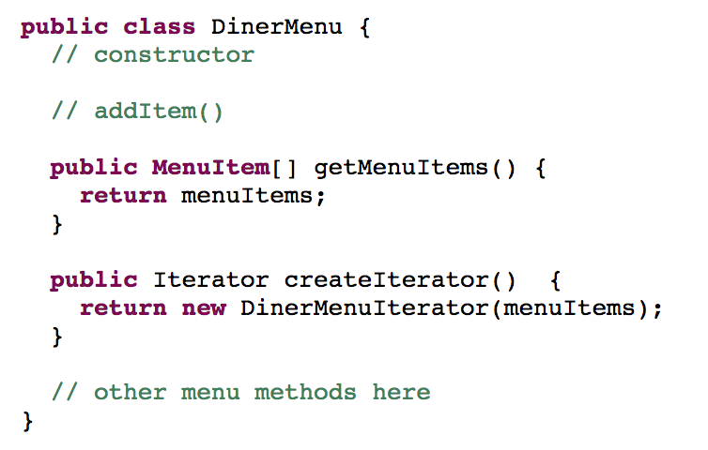
update diner menu

Slide 25
previously …

Slide 26
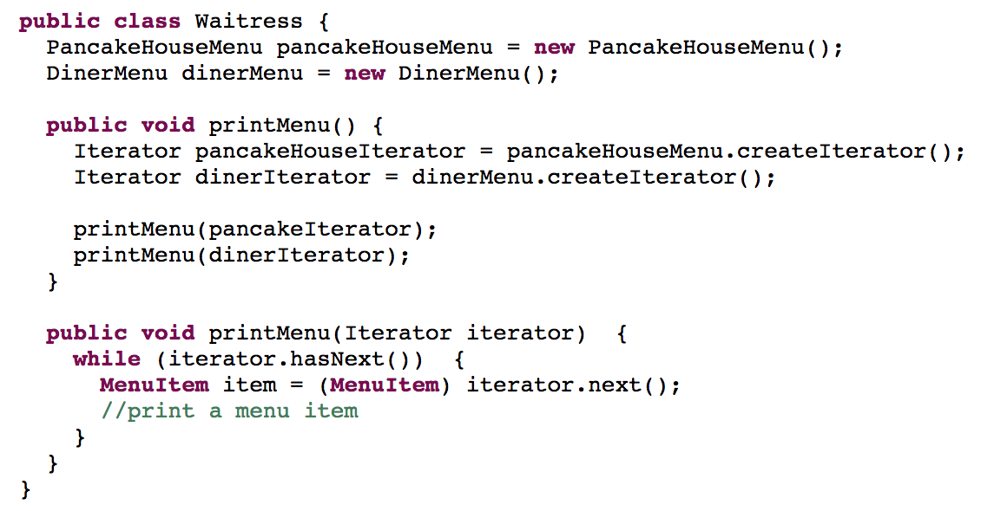
Now
Next() returns an Object. So you need to cast it to MenuItem
Notes:
Now we can iterate the items in both menus the same way.

Slide 27
Review generic types

Slide 28
ICE
Answer the questions on the ice while looking at the repl
https://replit.com/@engr120/iterator-inclass-iterator
Notes:
Now we can iterate the items in both menus the same way.

Slide 29
the iterator pattern
The Iterator Pattern provides a way to access the elements of an aggregate object sequentially without exposing its underlying
representation.

Slide 30
uml
Notes:
Why do we define an additional iterator class? Can we implement the iterator in the menu class?

Slide 31
design principle
We went to a lot of trouble to create a separate iterator class, and it would not have been that hard to let the Aggregate class provide the hasNext() and next() methods.
Each time we add a responsibility to a class (e.g. providing a way to iterate through the collection), we open ourselves up to another source of change.
It can be very hard to know when a responsibility is part of the core mission of a class and when it should be separated.
A class should have only one reason to change.

Slide 32
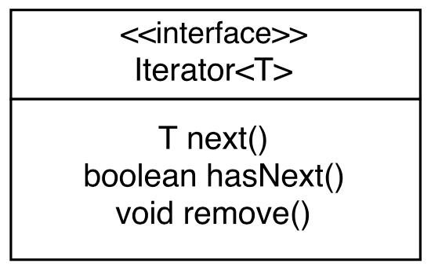
java.util.iterator

Slide 33
Buy one, get one free
Where does the “forEach” in notifyObservers() come from?
How do you know a List would have “forEach”?

Slide 34
In reality
The standard Java library has implemented a structure just like the Iterator pattern
Any Iterable must have a iterator() method which returns an Iterator
Similar to createIterator()
If we declare our menus as Iterables, we can make use other benefits the standard library has created for Iterables
https://replit.com/@engr120/iterator-inclass-iterable
Where we use the Java Iterator, not ours
The Menus are Iterables with iterator() method

Slide 35
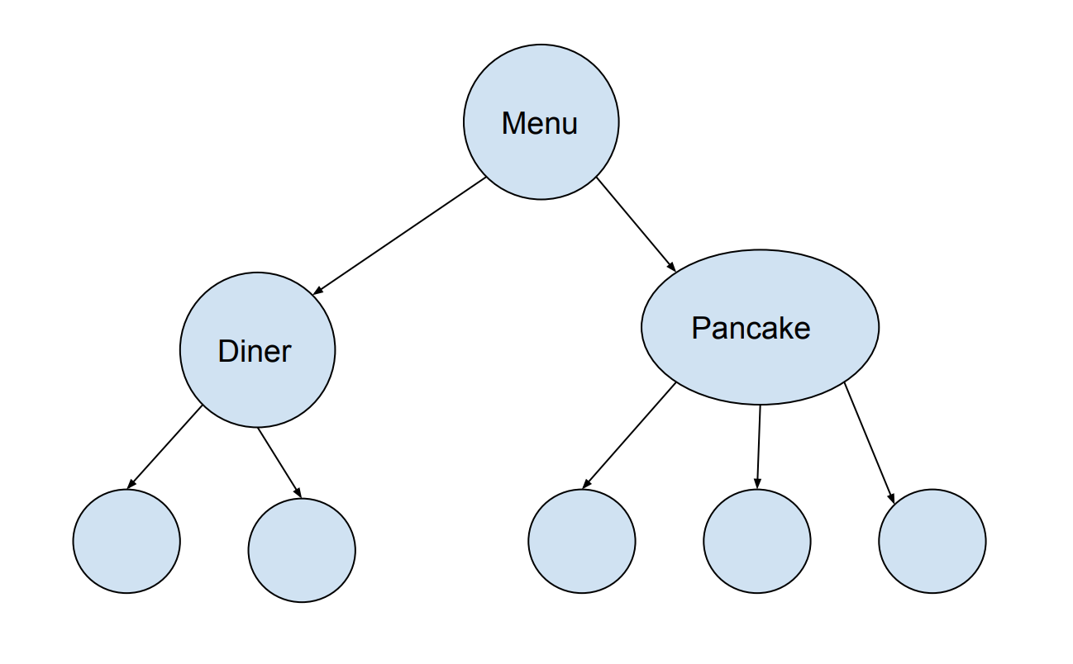
Composite pattern
TWO sub-menus
Menu items under the two sub-menus
Notes:
Exactly two sub-menu

Slide 36
structure of the menu
TWO sub-menus
Menu items under the two sub-menus
Notes:
Exactly two sub-menu

Slide 37
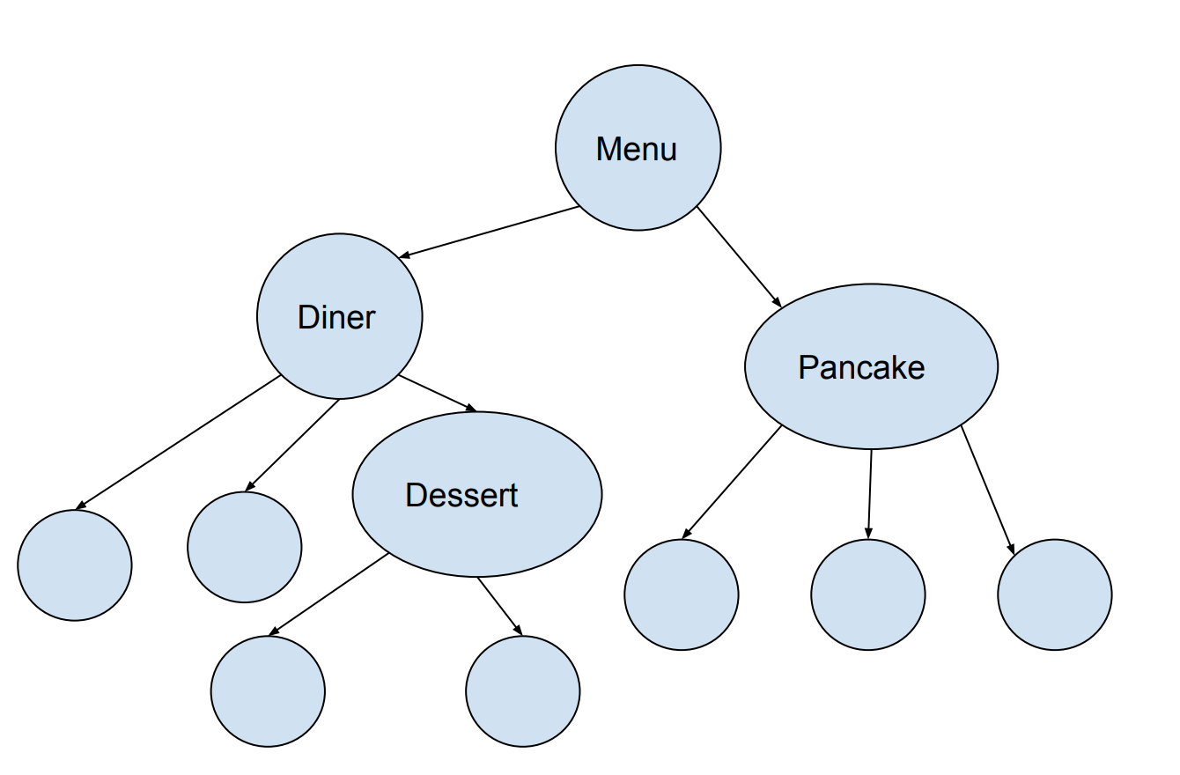
dessert menu
Notes:
a menu under a menu

Slide 38
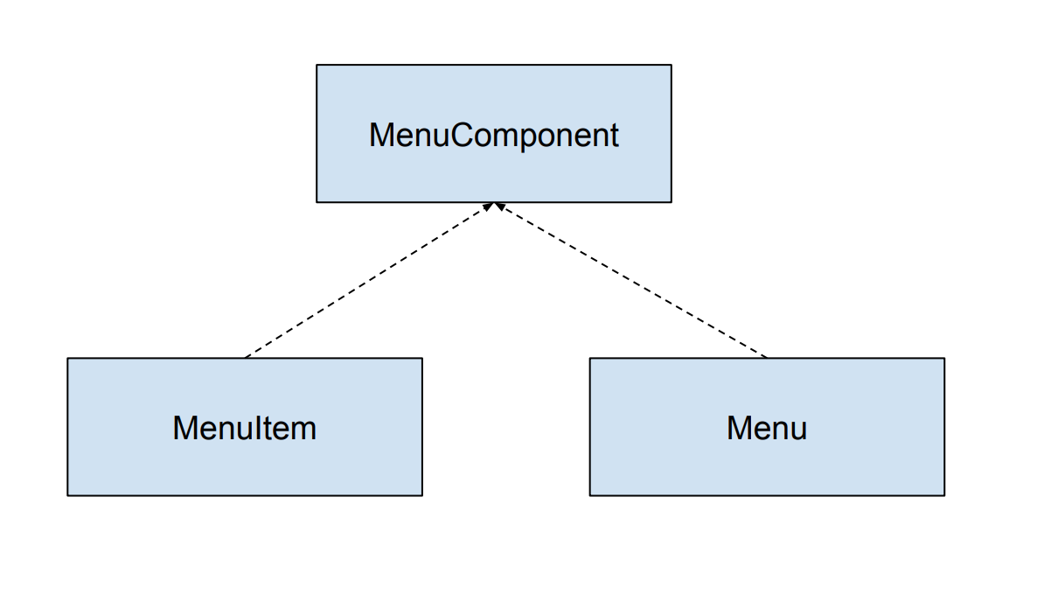
menu and menu item
Can we encapsulate the difference between the menu and the menu items?

Slide 39
printing
Menu: Has children (menu items), print the children.
MenuItem: No children, print the item.
https://repl.it/@engr120/composite-menu

Slide 40
Simpler example
https://repl.it/@engr120/composite-backpack-ice
You can put textbooks or smaller backpacks in a backpack
Given a backpack, print what it contains.
A textbook prints the title, e.g. “Design Patterns”
A backpack just prints “Backpack: “
Textbooks/backpack in a smaller backpack indented by two more spaces
print(string indent)

Slide 41
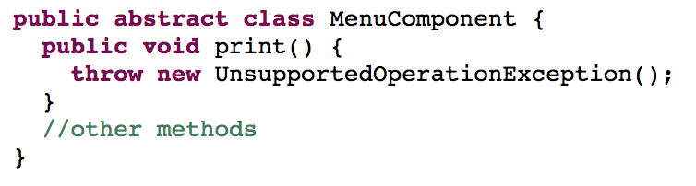
menucomponent

Slide 42
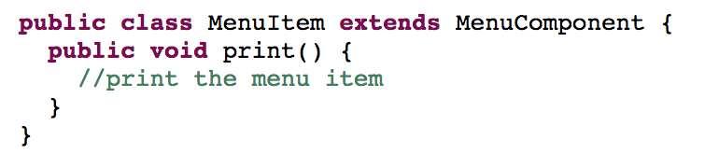
menuitem

Slide 43
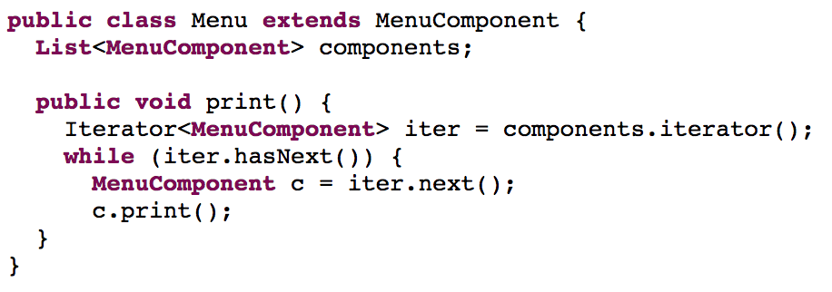
menu
A menu item or a menu

Slide 44
the waitress prints
https://repl.it/@engr120/composite-menu

Slide 45
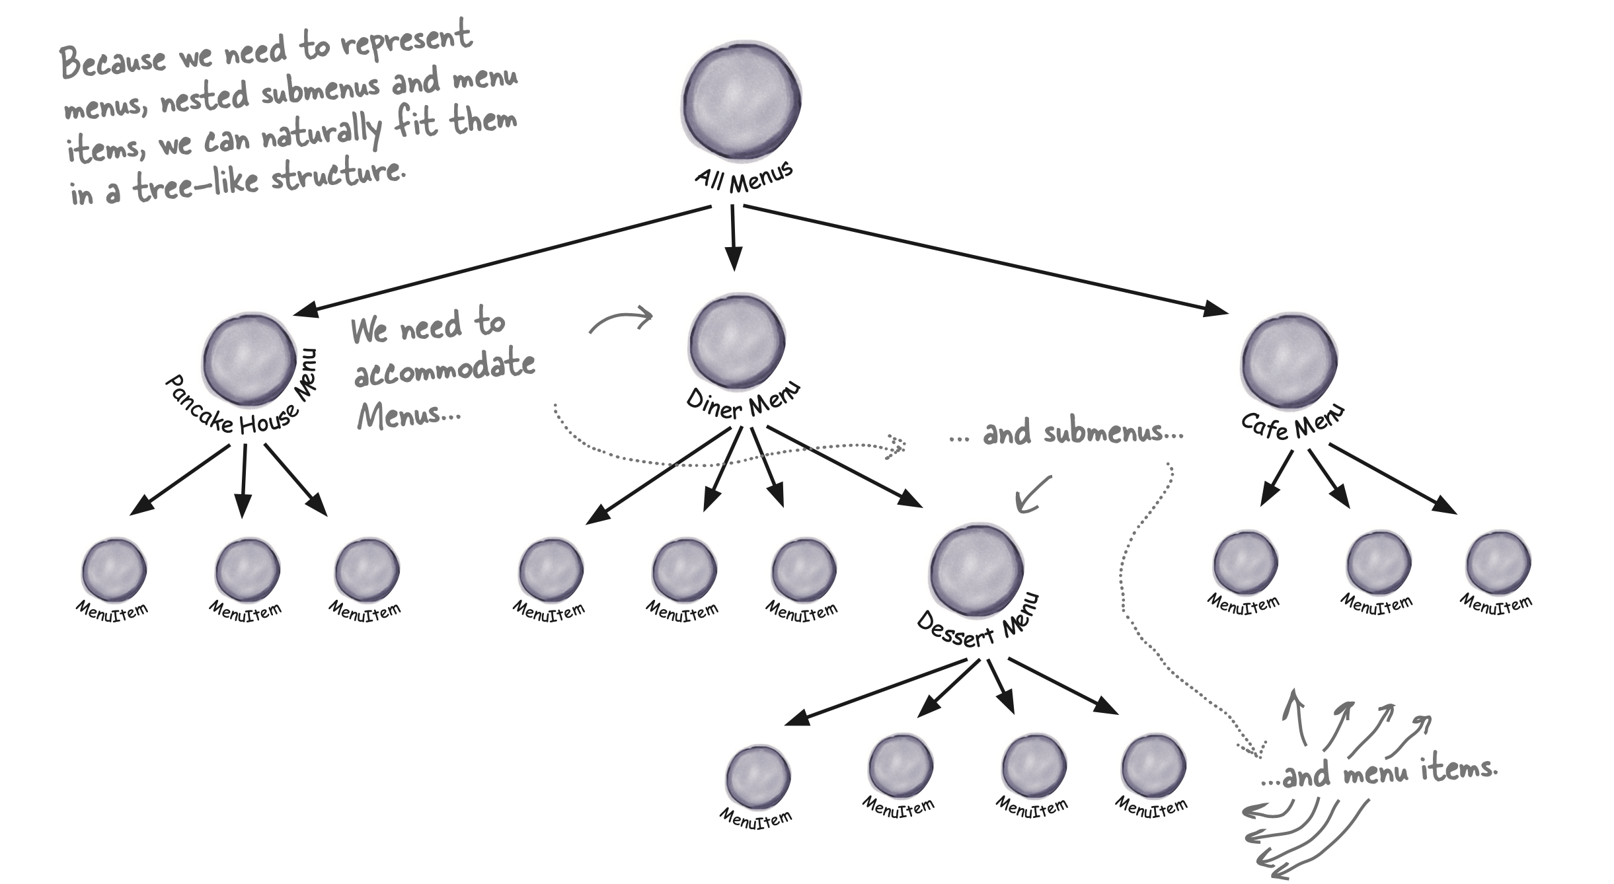

Slide 46
composite pattern
The Composite Pattern allows you to compose objects into tree structures to represent part-whole hierarchies. Composite lets clients treat individual objects and compositions of objects uniformly.

Slide 47
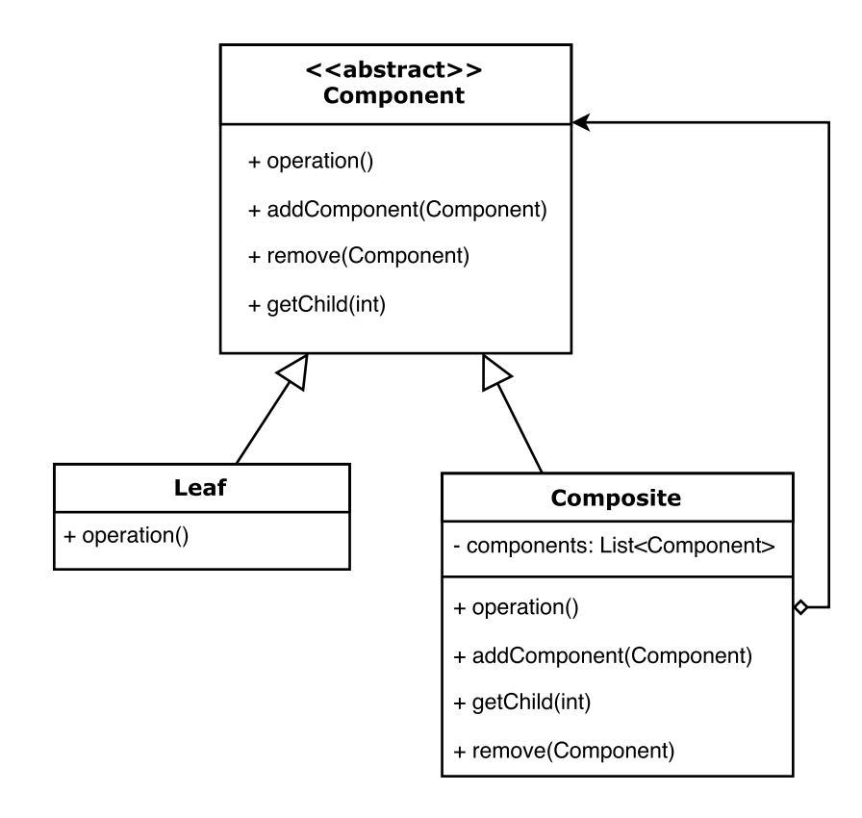
uml

Slide 48
transparency vs. safety

Slide 49
homework
Read chapter 9
Skip the “CompositeIterator” part
Exam 2: Singleton, Factory, Command, Iterator, Composite
Nov 12 in class

